Slide 1
Validation
Dr. Mehmet Yasin Ulukuş

Slide 2
Generalization
Generalization refers to how well the concepts learned by the model applies to specific examples not seen by the model when it was learning.
Note that this is the real purpose of building a model (learn from the data and use it in real life).
A good model make predictions in the future on data the model has never seen which we call out of sample error $E_{out}$.
Hence we want a model that provides as small $E_{out}$ as possible.
Overfitting and underfitting are the two biggest causes for poor performance of algorithms.

Slide 3
Overfitting
Overfitting refers to a model that models fits the training data too well (more than it should).
Overfitting is the phenomenon where fitting the observed facts (data) well no longer indicates that we will get a decent error out of training set, and may actually lead to the opposite effect.
Overfitting occurs when the learning model is more complex than is necessary to represent the target function.
The model uses its additional degrees of freedom to fit idiosyncrasies in the data (for example, noise), yielding a final hypothesis that is inferior.
The ability to deal with overfitting is what separates professionals from amateurs in the field of learning from data.

Slide 4
Overfitting
Consider a simple one-dimensional regression problem with five data points
The target function is a 2nd order polynomial
We added a little noise to create the data points.
We use 5 data points to fit a 4th order polynomial

Slide 5
Overfitting
Consider a simple one-dimensional regression problem with five data points
The target function is a 2nd order polynomial
We added a little noise to create the data points.
We use 5 data points to fit a 4th order polynomial
Though the target is simple, the learning algorithm used the full power of the 4th order polynomial to fit the data exactly, but the result does not look anything like the target function
The data has been overfit

Slide 6
Overfitting
The model has zero training error
However the model does a very bad job at generalization
There are different ways of dealing with this problem
We will be covering two main approaches (1) validation and (2) regularization to deal with overfitting
The data has been overfit

Slide 7
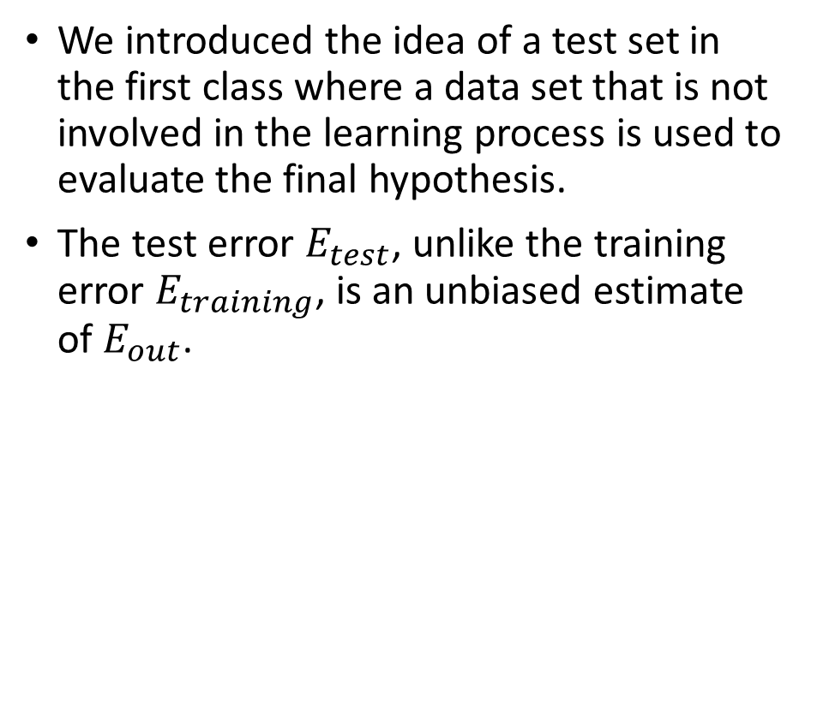
Overfitting
We introduced the idea of a test set in the first class where a data set that is not involved in the learning process is used to evaluate the final hypothesis.
The test error $E_{test}$, unlike the training error $E_{training}$, is an unbiased estimate of $E_{out}$.

Slide 8

Overfitting
We introduced the idea of a test set in the first class where a data set that is not involved in the learning process is used to evaluate the final hypothesis.
The test error $E_{test}$, unlike the training error, is an unbiased estimate of $E_{out}$.

Slide 9
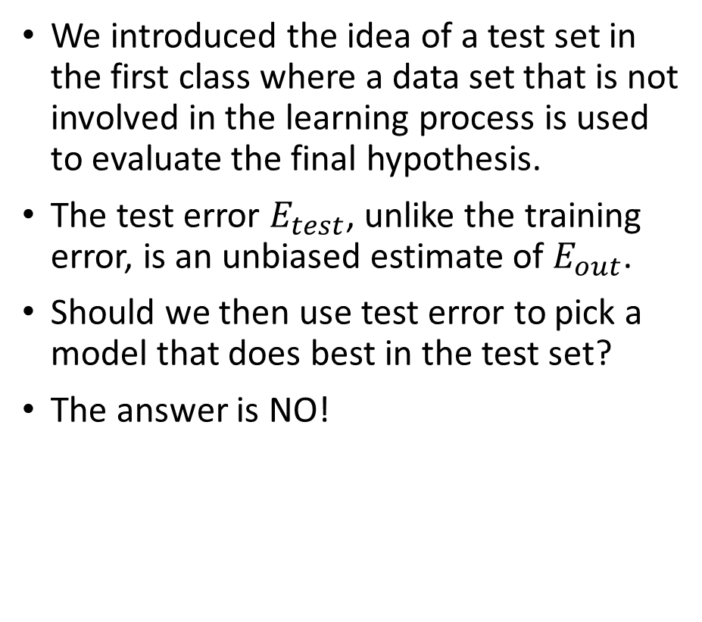
Overfitting
We introduced the idea of a test set in the first class where a data set that is not involved in the learning process is used to evaluate the final hypothesis.
The test error $E_{test}$, unlike the training error, is an unbiased estimate of $E_{out}$.
Should we then use test error to pick a model that does best in the test set?
The answer is NO!

Slide 10
Validation
The idea of a validation set is almost identical to that of test set.
We remove a subset from the data; this subset is not used in training.
We then use this held-out subset to estimate the out-of-sample error.
The held-out set is effectively out-of-sample, because it has not been used during the learning.
However, there is a difference between a validation set and a test set.
Although the validation set will not be directly used for training, it will be used in making certain choices in the learning process.
For example tuning the parameters of the model (choosing k in KNN, choosing the order of polynomial function in regression) or selecting the set of features to be used in the model.
The minute a set affects the learning process in any way, it is no longer a test set.

Slide 11
Wrong Approach
Split your data set into training set and test set
Assume you try three different parameters or models (train on training evaluate on test)
Training Set
Test Set
Training Set
Test Set
MSE Model 1
Training Set
Test Set
MSE Model 2
Training Set
Test Set
MSE Model 3

Slide 12
Wrong Approach
Pick the model with the smallest test MSE
But we have seen test set several times, isn’t trying different model a part of training process? We made the test as part of the training, hence it lost the property being an unbiased metric of generalization error.
Training Set
Test Set
MSE Model 1
Training Set
Test Set
MSE Model 2
Training Set
Test Set
MSE Model 3

Slide 13
Validation
The best approach for both problems is to randomly divide the dataset into three parts: training set, a validation set, and a test set.
The training set is used to fit the models; the validation set is used to estimate prediction error for model selection; the test set is used for assessment of the generalization error of the final chosen model.
Ideally, the test set should be kept in a “vault,” and be brought out only at the end of the data analysis.
The model choices, like determining the parameters of the model should be done using validation set.
Training Set
Validation Set
Test Set

Slide 14
Correct Approach
Training Set
Validation Set
Test Set
Training Set
Validation Set
MSE Model 1
Training Set
Validation Set
MSE Model 2
Training Set
Validation Set
MSE Model 3
Training + Validation Set
Test Set
Retrain your model with selected parameters on Training Data
Final Evaluation

Slide 15
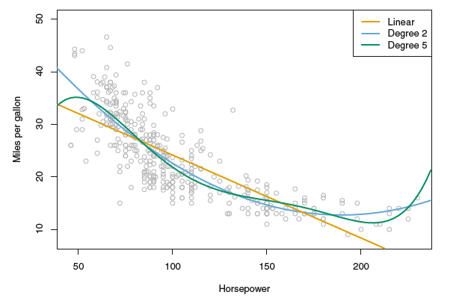

Validation Set Approach
Consider Car example, in which the mpg (gas mileage in miles per gallon) versus horsepower is shown for a number of cars in the Auto data set
The data suggest a curved relationship
A simple approach for incorporating non-linear associations in a linear model is to include transformed versions of the predictors in the model

Slide 16
Validation Set Approach
The $R^{2}$ of the quadratic fit is 0.688, compared to 0.606 for the linear fit, and the p-value in for the quadratic term is highly significant
If including horsepower^2 led to such a big improvement in the model, why not include horsepower^3, horsepower^4, or even horsepower^5?
Overfitting ☺

Slide 17
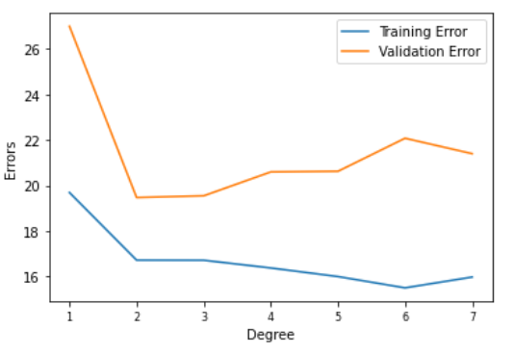
Validation Set Approach
We randomly split the 392 observations into two sets first, 20% of the data is preserved for final test.
We then split 312 observations into a training set containing 156 of the data points, and a validation set containing the remaining 156 observations
Model is fit using training set and MSE is computed using validation set
The validation set error rates that result from fitting various regression models on the training sample and evaluating their performance on the validation sample are shown in the figure

Slide 18
Validation Set Approach
The validation set MSE for the quadratic fit is considerably smaller than for the linear fit.
However, the validation set MSE for the cubic fit is actually slightly larger than for the quadratic fit.
This implies that including a cubic term in the regression does not lead to better prediction than simply using a quadratic term

Slide 19
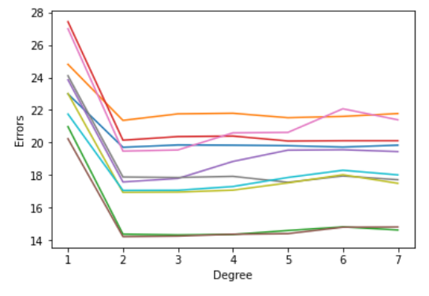
Validation Set Approach
Recall that in order to create the figure, we randomly divided the data set into two parts, a training set and a validation set
If we repeat the process of randomly splitting the sample set into two parts, we will get a somewhat different estimate for the test MSE

Slide 20
Validation Set Approach
All ten curves indicate that the model with a quadratic term has a dramatically smaller validation set MSE than the model with only a linear term
Furthermore, all ten curves indicate that there is not much benefit in including cubic or higher-order polynomial terms in the model
But it is worth noting that each of the ten curves results in a different test MSE estimate (be careful these are not real test MSE scores, validation MSE is an estimate of test MSE) for each of the ten regression models considered

Slide 21
Validation Set Approach
The validation set approach is conceptually simple and is easy to implement.
But it has two potential drawbacks:
The validation estimate of the test error rate can be highly variable, depending on precisely which observations are included in the training set and which observations are included in the validation set (as seen in the previous figure)
In the validation approach, only a subset of the observations are used to fit the model.
Statistical methods tend to perform worse when trained on fewer observations, this suggests that the validation set error rate may tend to overestimate the test error rate for the model fit on the entire data set.

Slide 22
Cross-Validation
To make the algorithm learn better we would like to make the training set as big as possible
However, if we make this choice, we lose the reliability of the validation estimate since now the validation error is computed using a small sample
We present cross-validation, a refinement of the validation set approach that addresses these two problems
We will cover two basic cross-validation techniques: (1) leave-one-out cross validation (LOOCV), and (2) k-fold cross validation

Slide 23
LOOCV
Like the validation set approach, LOOCV involves splitting the set of observations into two parts.
However, instead of creating two subsets of comparable size, a single observation $(x_{1}, y_{1})$is used for the validation set, and the remaining observations $\{(x_{2}, y_{2}), . . . , (x_{n}, y_{n})\}$make up the training set.
Since $(x_{1}, y_{1})$was not used in the fitting process, $MSE_{1}={\left(y_{1}−{\hat{y}}_{1}\right)}^{2}$ is an unbiased estimator of the test error
It is a poor estimate because it is highly variable, since it is based upon a single observation $\left(x_{1}, y_{1}\right)$
But we can repeat the procedure by selecting each $\left(x_{i}, y_{i}\right)$ in the validation set one at a time and leave the remaining ones in the training set, then compute $MSE_{i}={\left(y_{i}−{\hat{y}}_{i}\right)}^{2}$

Slide 24
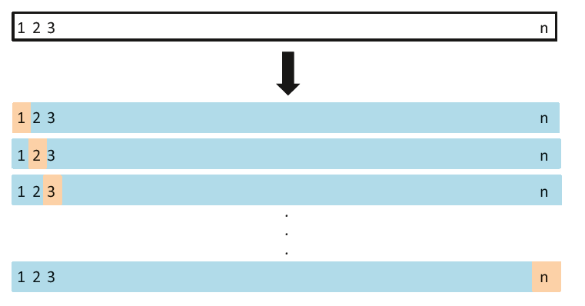
LOOCV
Schematically
The LOOCV estimate for the test MSE is the average of these n error estimates
$$CV_{(n)}=\frac{1}{n}\sum_{i=1}^{n}{MSE_{i}}$$
Test Set

Slide 25
LOOCV
LOOCV has a couple of major advantages over the validation set approach.
In LOOCV, we repeatedly fit the statistical learning method using training sets that contain n − 1 observations, almost as many as are in the entire data set.
Hence, the model fitted with more data points is better
Also there is no randomness in the method since there are no random splits
In other words, performing LOOCV multiple times provides the same result, unlike validation set approach

Slide 26
LOOCV
LOOCV has the potential to be expensive to implement, since the model has to be fit n times.
This can be very time consuming if n is large, and if each individual model is slow to fit
LOOCV is a very general method, and can be used with any kind of predictive modeling.
For example we could use it with logistic regression or linear discriminant analysis, or any of the methods discussed in later classes
Note that we need to replace MSE with other types of error measures depending on the method

Slide 27
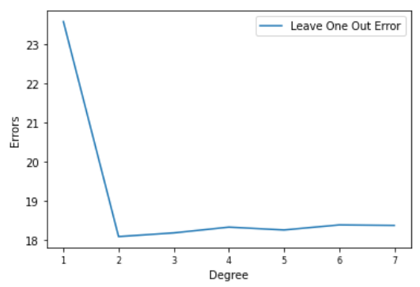
LOOCV
We used LOOCV on the Auto data set in order to obtain an estimate of the test set MSE

Slide 28
K-fold Cross Validation
An alternative to LOOCV is k-fold CV.
This approach involves randomly dividing the set of observations into k groups, or folds, of approximately equal size.
The first fold is treated as a validation set, and the method is fit on the remaining k − 1 folds
The mean squared error, MSE1, is then computed on the observations in the held-out fold
This procedure is repeated k times; each time, a different group of observations is treated as a validation set.
This process results in k estimates of the test error, $MSE_{1}, MSE_{2}, . . . ,MSE_{k}$.
The k-fold CV estimate is computed by averaging these values
$$CV_{(k)}=\frac{1}{k}\sum_{i=1}^{k}{MSE_{i}}$$

Slide 29
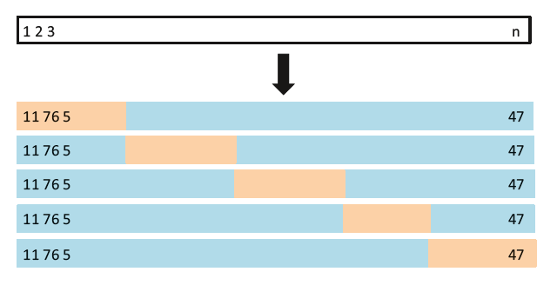
K-fold Cross Validation
Figure illustrates the k-fold CV approach.
In practice, one typically performs k-fold CV using k = 5 or k = 10
Test Set

Slide 30
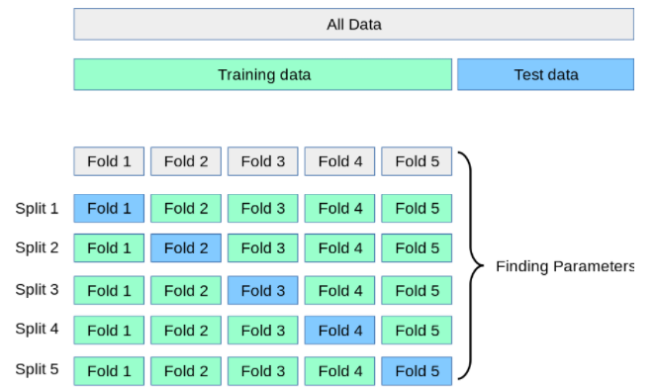



K-fold Cross Validation
Repeat this process for
all different models and
parameters and pick the best one
Retrain your model with selected parameters on Training Data

Slide 31
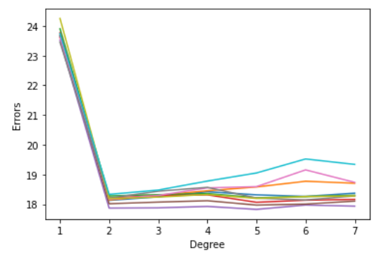
K-fold Cross Validation
K-fold is computationally less expensive than LOOCV
Some statistical learning methods have computationally intensive fitting procedures, and so performing LOOCV may pose computational problems, especially if n is extremely large.
Figures shows validation errors with LOOCV and 10-fold CV
Results are similar

Slide 32
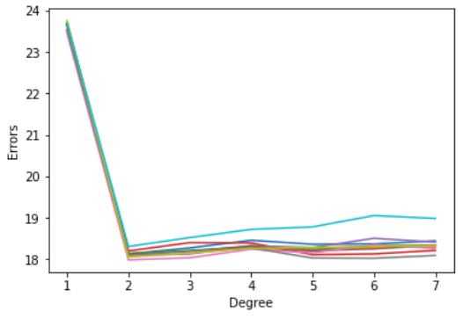
K-fold Cross Validation
As we can see from the figure, there is some variability in the CV estimates as a result of the variability in how the observations are divided into ten folds.
But this variability is typically much lower than the variability in the test error estimates that results from the validation set approach

Slide 33
Cross-Validation on Classification Problems
Cross-validation can also be a very useful approach in the classification setting when Y is qualitative
In this setting, cross-validation works just as described earlier in this chapter, except that rather than using MSE to quantify test error, we instead use the number of misclassified observations.
For instance, in the classification setting, the LOOCV error rate takes the form
$$CV_{(n)}=\frac{1}{n}\sum_{i=1}^{n}{ERR_{i}}$$
where $ERR_{i}=I(y_{i}≠{\hat{y}}_{i})$
The k-fold CV error rate and validation set error rates are defined analogously
Accuracy or other measures can also be used similarly (see Jupyter notebook KNN_Validation)

